Slide 1
FAT BIKE MECHANICS
Ellie Thompson
Riverbrook Bike & Ski
Hayward, WI

Slide 2
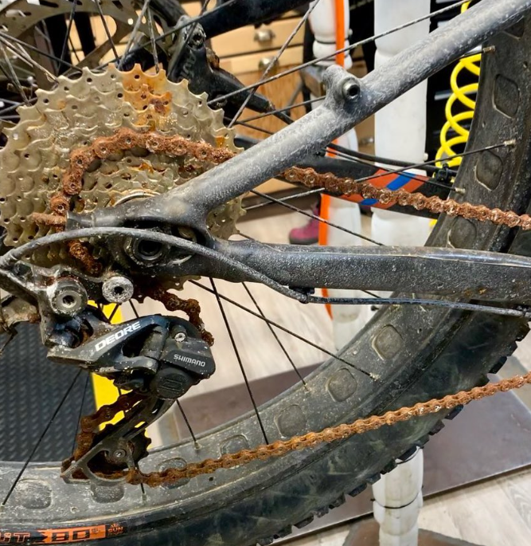
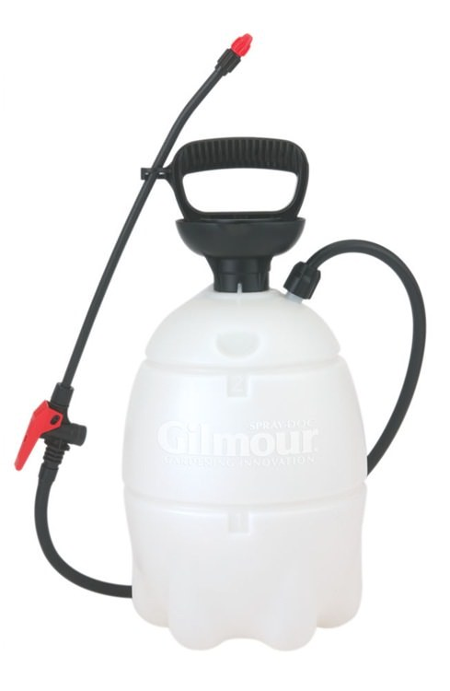
Prep For The Winter Season
Before yearly storage:
Get your bike serviced or note any mechanical issues
Thoroughly clean your bike (salt is the enemy!)
Protectants like Muc-Off Silicone Shine will reduce salt adhesion
Discover mechanical issues before you’re outside in cold weather
Time is of the essence when weather conditions are bad
Refresh sealant, inspect your gear, etc.

Slide 3
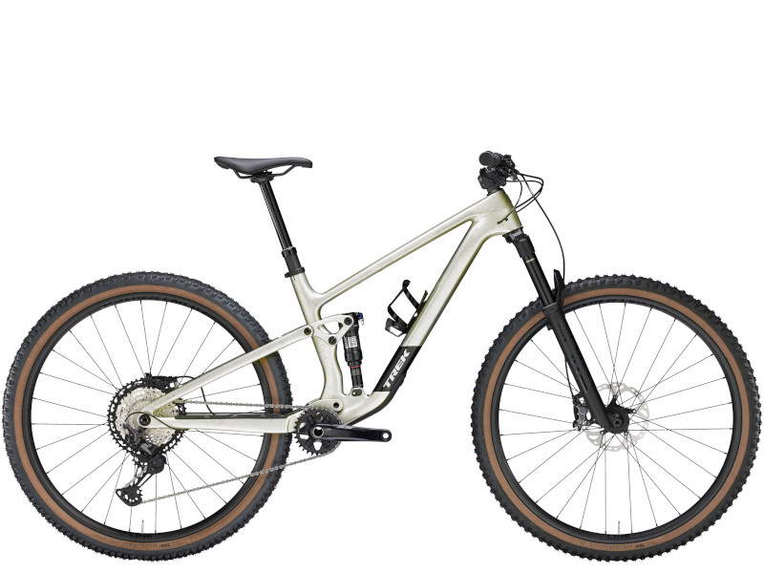
Pre-Ride Check
1. Air: Make sure your tires are properly inflated. Inspect the condition of your tires, looking for damage to the sidewall or tread.
2. Brakes: Grab your brake levers as you roll your bike forward. Observe braking response & listen for abnormal noises. Verify that your levers don’t go all the way to the bar.
3. Chain: Verify that your chain is clean & lubed
4. Cockpit: Confirm that your saddle, handlebar, grips, brake & shift levers are not loose.
5. Axles: Make sure your front & rear thru or quick release axles are tight and that your wheels don’t wobble
4
1
2
5
3
Lubrication
Keep your bike clean
Happy Bike = Successful & Safe Riding
Dirt is abrasive
Dirt shortens lifespan of components
Chain
Suspension stanchions
Pivot points
Brakes
Bleed hydraulic brakes 1 -2 yrs
Avoid contamination
Inspect for pad wear several times a year
Tires
Low pressure can pinch tubes
Sealant dries out ~ 3 months
Valve cores clog

Slide 4
Be Familiar With Trailside Repairs
The level of risk/difficulty associated with a particular ride should correlate to your knowledge level & the equipment you carry
Time is of the essence when weather conditions are bad
Modify/swap tools so they are easier to use with cold hands
Rope loops, bright duct tape, etc. in case you drop them in snow

Slide 5
Tubeless Setups
Often more finicky than traditional MTBs, but with even greater rewards
Tire pressures with tubeless can go as low as 1 - 2 psi. Tubes run the risk of pinch flats & going below 4 - 5 psi can be risky
A fat bike tube can weigh as much as 450 grams, or just under a pound!
Carrying a spare tube is still recommended

Slide 6
Sealant Temperature Ranges
- 20F
- 20F
- 4F
- 5F

Slide 7
Tubeless Continued
When on the trail, add more sealant without breaking the tire bead
Use a valve core removal tool and a small bottle of sealant with a tapered tip
If you need to break the tire bead:
You will likely need a tube or a high volume CO2 cartridge to reseat it
Be prepared to put a tube in if necessary

Slide 8
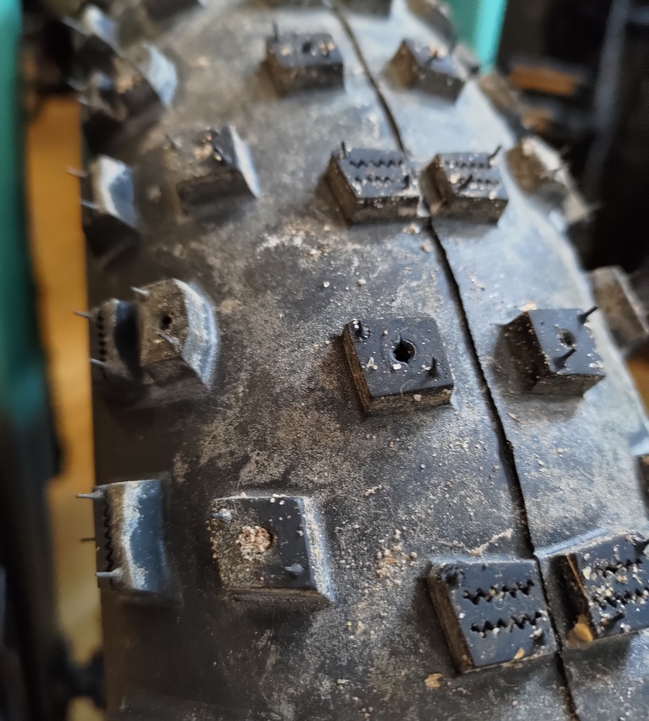
Are We Tired of Tires Yet?!
Some tires are sold pre-studded
Others will have open holes
Custom stud options abound
Try to ride 1 hour smoothly on pavement with minimal turning to bed in studs
Not good for summer use

Slide 9
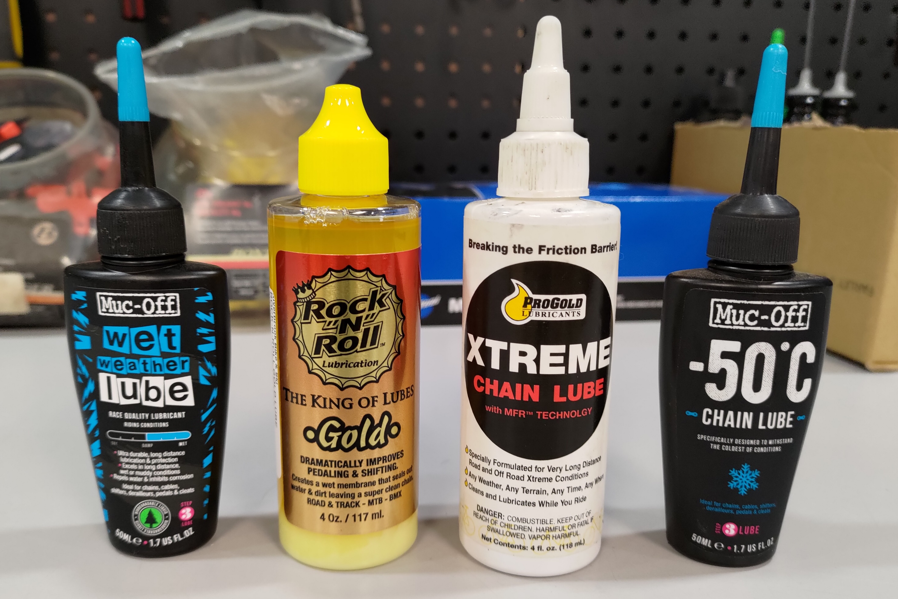
Chain Lube
Look for wetter lubes that are petroleum based
Wet lubes will be messier so it’s extra important to wipe off the excess
Some companies make specific cold weather lubes, but any petroleum heavy lube will drive out moisture and resist freezing
Dry lubes can be an opportunity for salt to stick

Slide 10
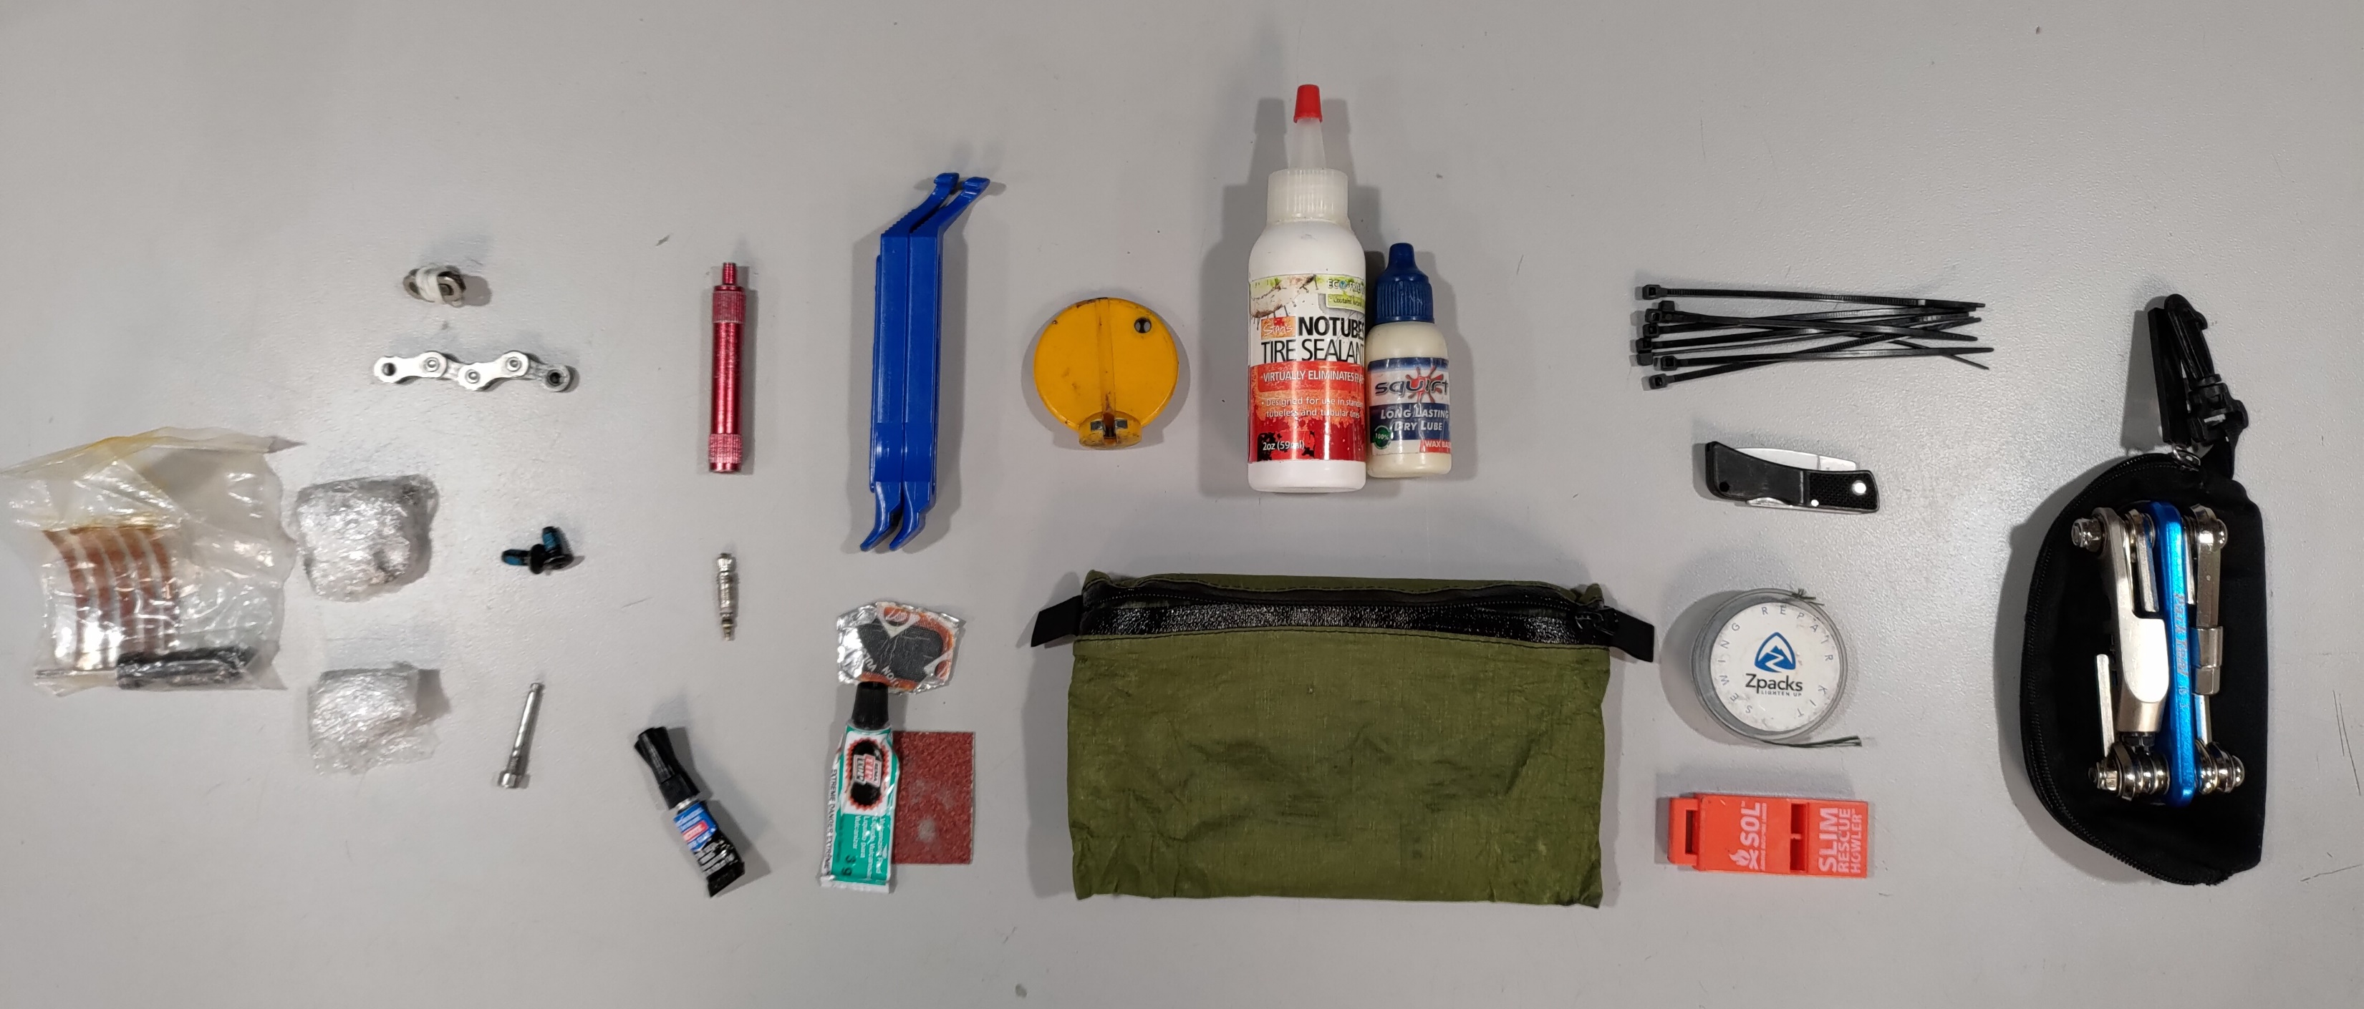
What to Carry?
Will depend on how remote/long the ride is
Tire plugs
Quick Link/spare chain
Spare cleat
Spare cleat screws
Rotor screws
Brake pad retaining screw
Valve core remover
Valve core
Super glue
Tire levers
Tube patching kit
Spoke wrench
13
10
12
14
15
7
2
1
3
16
19
5
8
17
4
6
9
11
18
Sealant
Chain lube
Zip ties
Pocket knife
Needle & thread
Emergency whistle
Multi-tool
*Not pictured: Tube, CO2, hand pump, lighter, etc.

Slide 11
Damn, I forgot my pump. It’s going to be a long walk to Kwik Trip!
Questions?

