Slide 1
Brrrrr! You want me to ride my bike
out there??

Slide 2
Dressing for fatbike success!
Christina Spencer
A self proclaimed champion shiverer

Slide 4
Fat biking is for you!
There is no “right” person
Everyone is different in how they feel cold, how much they sweat, how cold their hands/feet get
Don’t let people tell you they know what’s best for you!
Notes:
I feel like sometimes women feel like you need to look, dress, be a certain way to be a fat biker or a mountain biker. But really, you just need to love to be outside and ride a bike – fat biking is for you.
Also, well –meaning people will tell you the “ right” way to dress, but in actuality, we are all different. And you have to figure out what works for you at each temp range

Slide 5
Four Categories
Brisk - 25 and up
Chilly - 10-25
Cold - 0-10
Bitter – below zero
Notes:
This is the way I think about a ride. When I am getting ready to dree, I have a mental note about what each range means for me in terms of dress.
Now I totally forget each winter, but then I get back in the groove

Slide 6
Basic Components
Bib tights/winter tights
Under helmet hat
Ski helmet or bike helmet
Winter footwear
Winter gloves/heated gloves
Jacket or vest
Wind proof pants
Base layers
Pogies
Goggles / Eyewear
Gator
My special weapon – chemical toe warmers/heated socks
Notes:
Describing the basic components of dress

Slide 7
Clothing considerations
Wicking material
Technical fabrics
Wool
Pieces that allow you to move
Especially when layering
Especially your knees!!
Everyone is a little different
Trial and error
You are never wrong about you

Slide 8
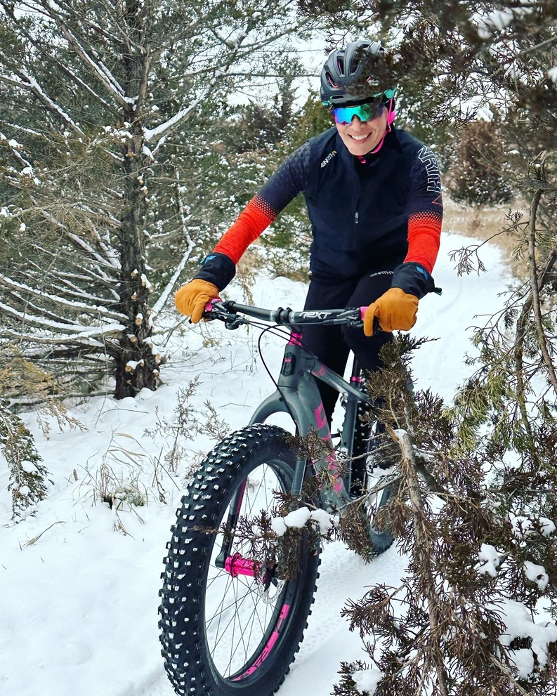
Brisk (25 and up)
Bibtights or bike shorts
plus pants
Under helmet hat/ear band
with regular helmet
Vest or jacket
No pogies (or maybe you
leave them on)
- Glasses vs goggles
Notes:
This what I wear in this temp range.

Slide 10
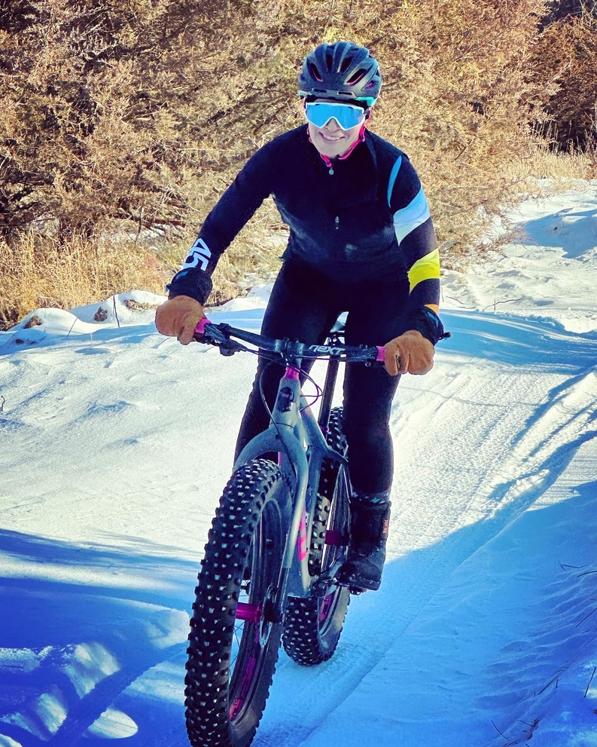
Chilly (10-25)
Regular helmet (or ski helmet)
Under hat
Glasses with more coverage (or goggles)
Pogies or not
Extra bottom layer or not

Slide 13
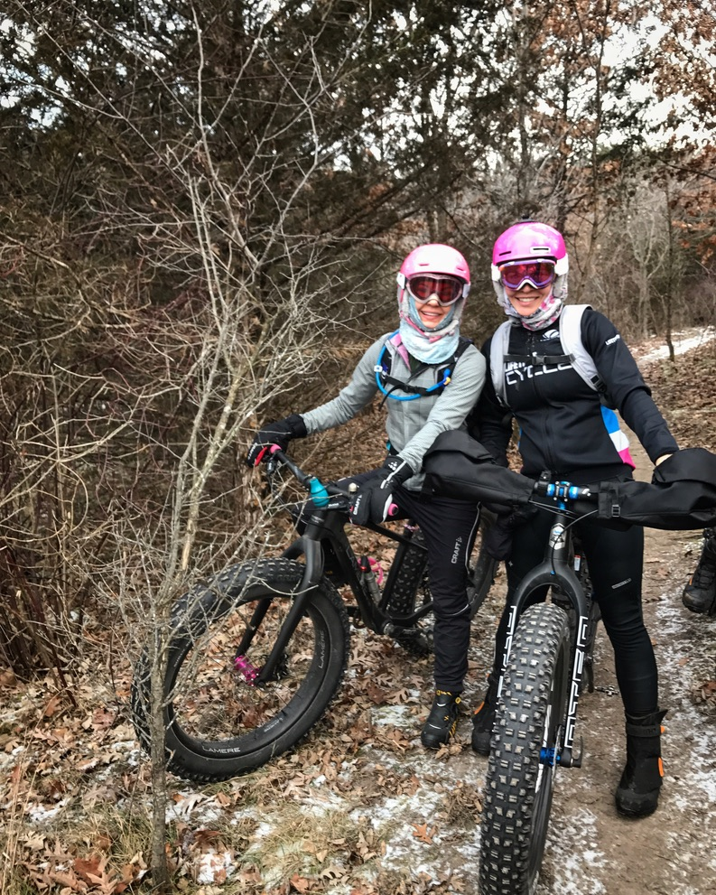
Cold (0-10)
Ski helmet
Two bottom layers
Goggles
Gator
Pogies

Slide 17
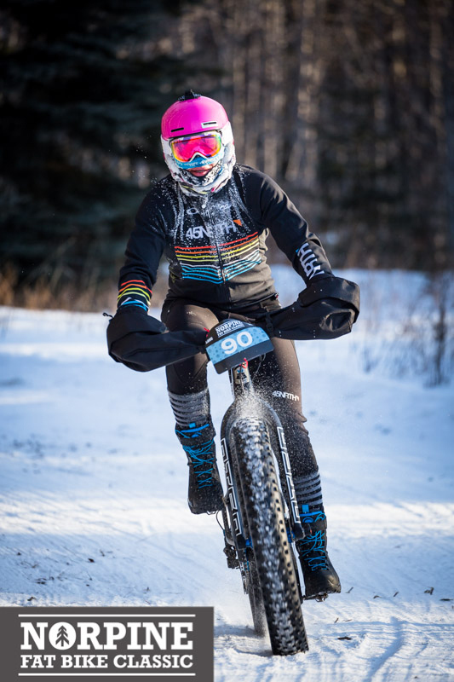
Bitter (below zero)
Ski helmet
Goggles
Full face coverage
Pogies
Extra layer
Nose coverage

Slide 18
Notes:
The nose sash!
They also make products that do this for you

Slide 19
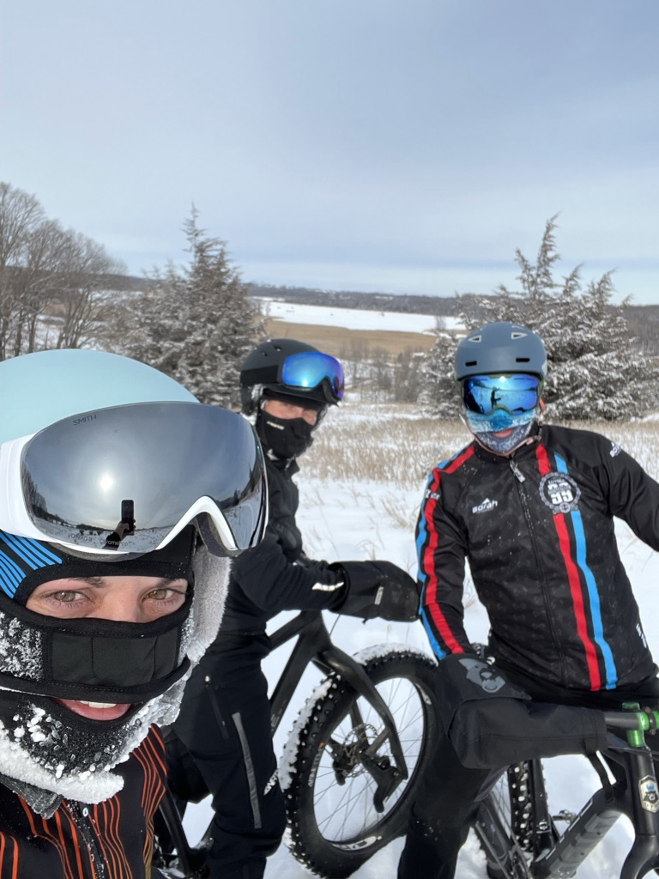

Slide 20
Footwear!
Most important qualities
Water proof
Wind proof
Thick soles
Good pedal contact/connection

Slide 22
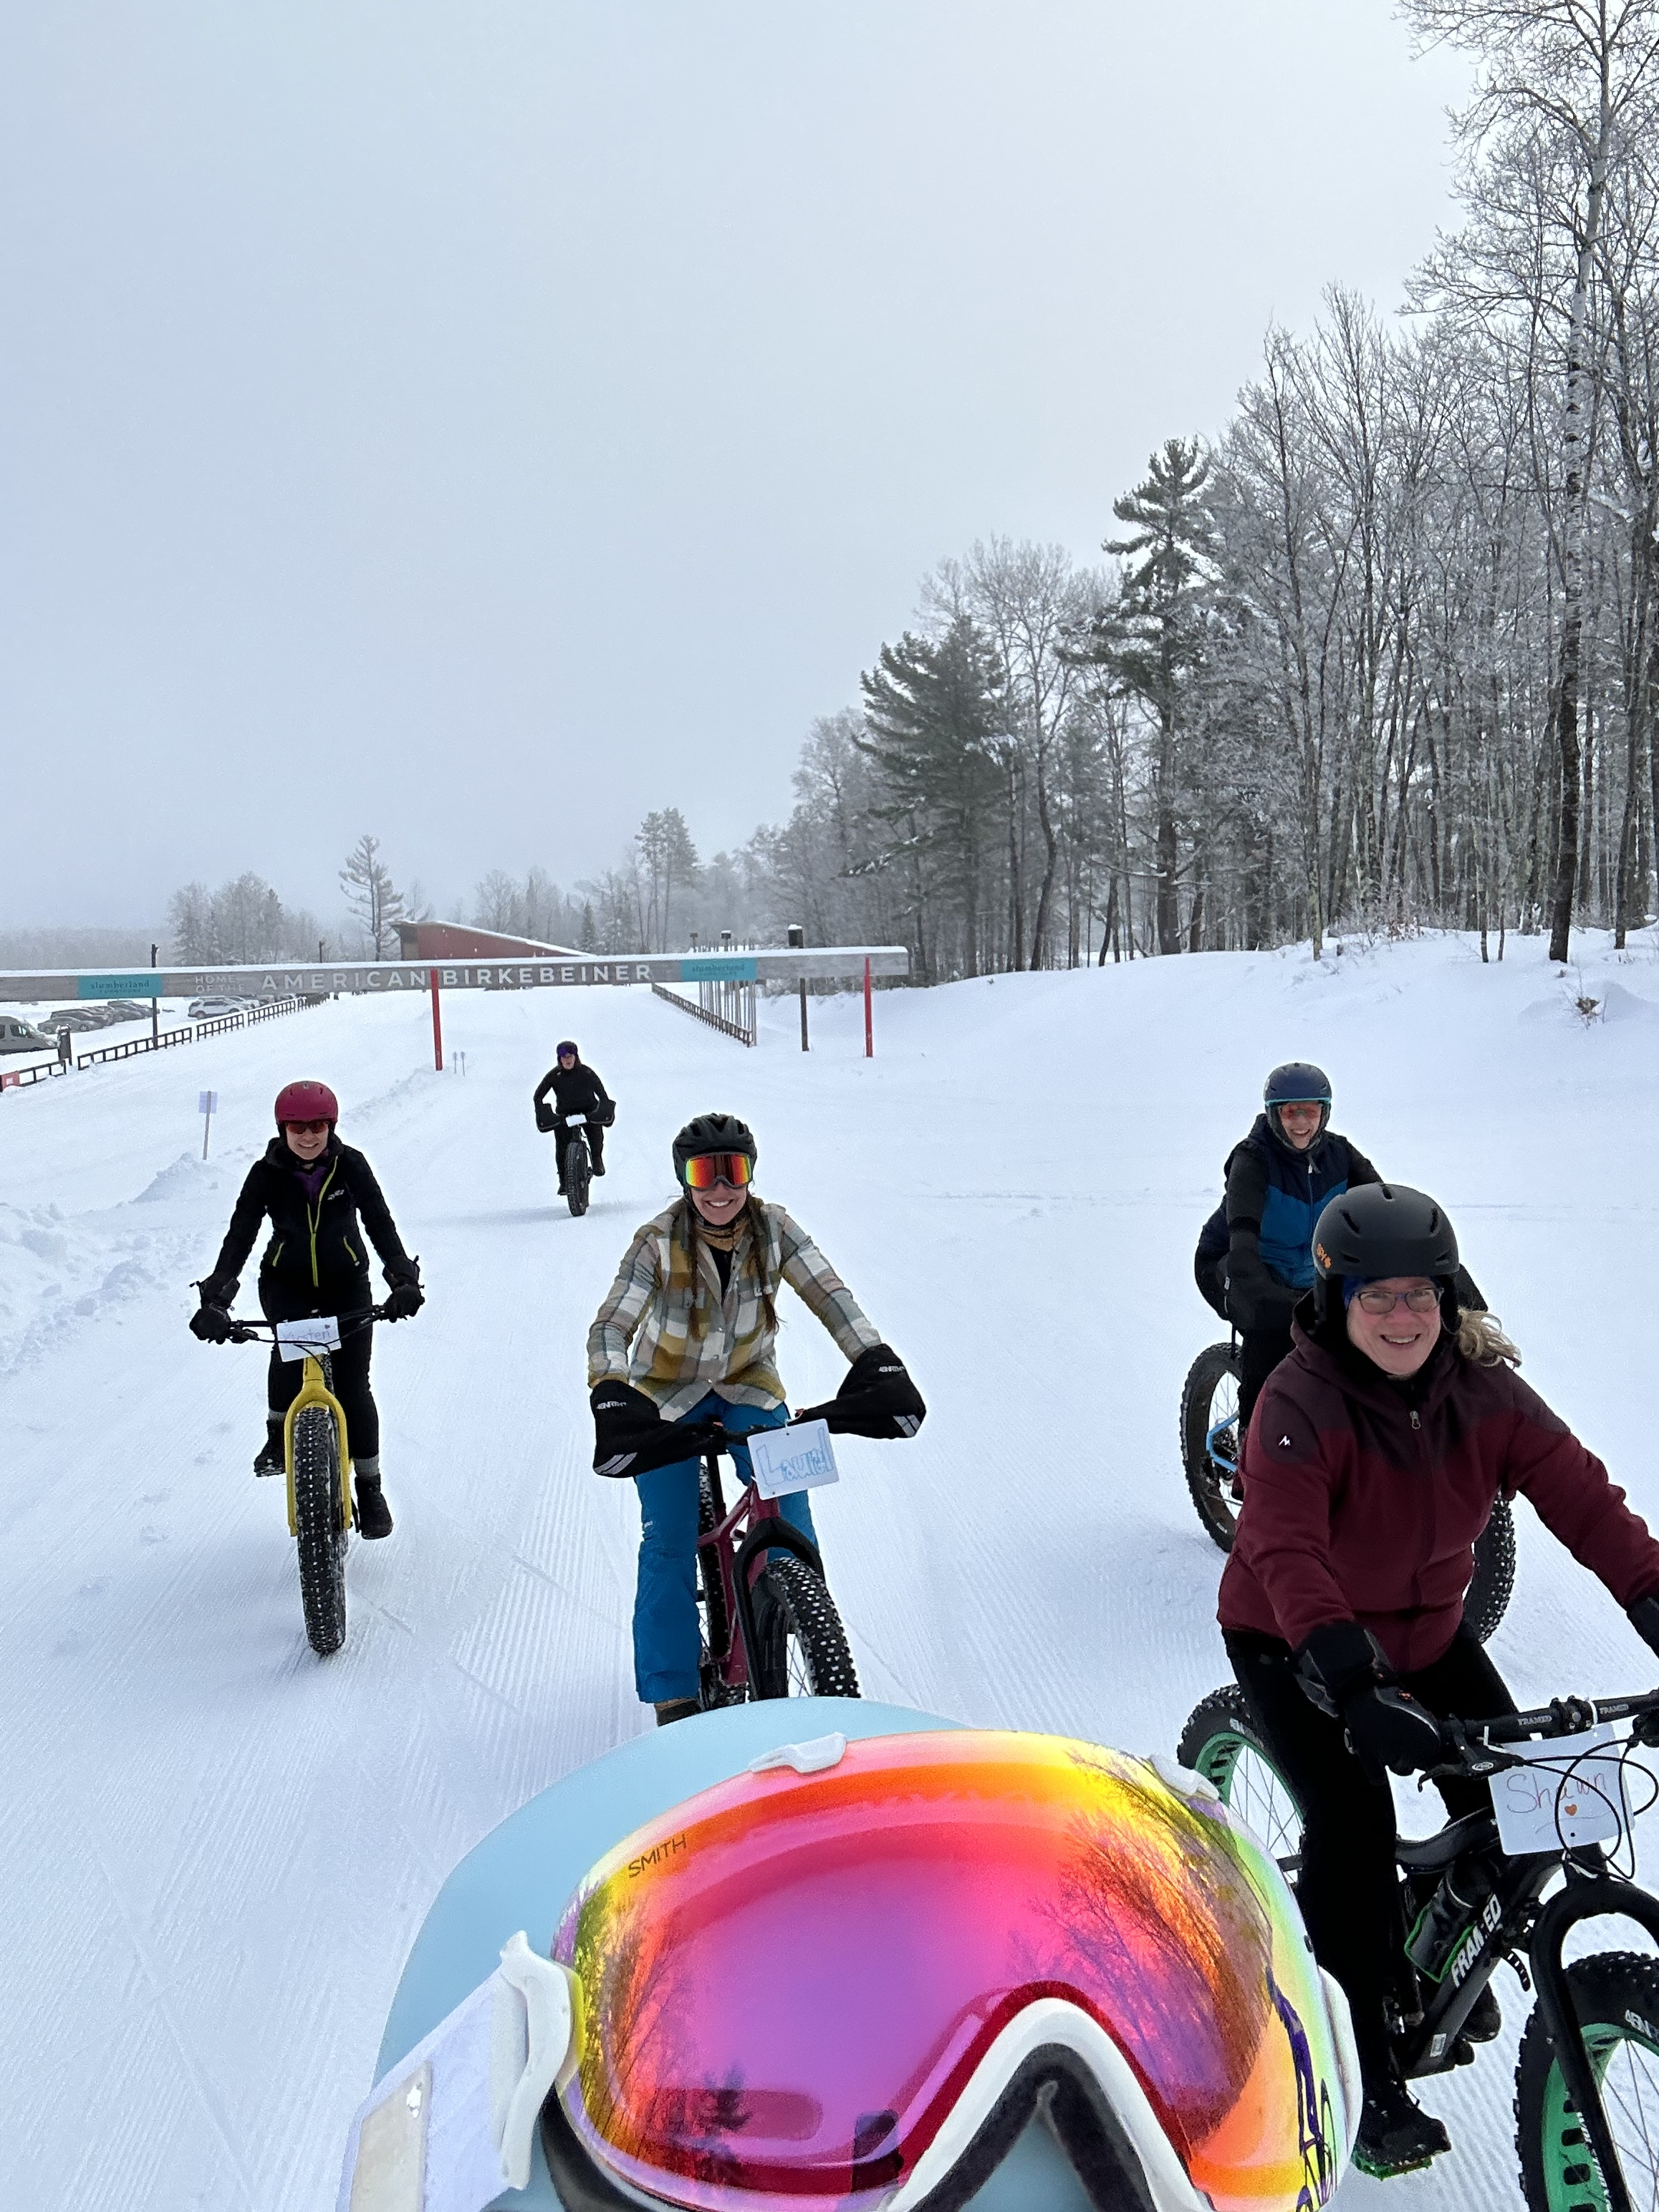

Slide 23
Special Circumstances
Blizzard
Racing
Hydration
Notes:
Blizzard – goggles are necessary or the snowflakes and wind get in your eyes
Racing (whether you are “racing” or participating”) you may need to consider dialing back a layer or the thickness of your usual layer. This is because you will likely go faster than your training pace, and you won’t be taking as many social breaks
Hydration on a bike in winter can be challenging. Camelbaks are used (under a jacket) – need to use the blow-back technique, but even then the bite valve often freezes. Water bottles turned upside down, filled with hot water. Containers where you stop and remove the top, or keep tucked in clothes. Depending on length of time, temp and situation (racing vs social) any or these can work.

Slide 25
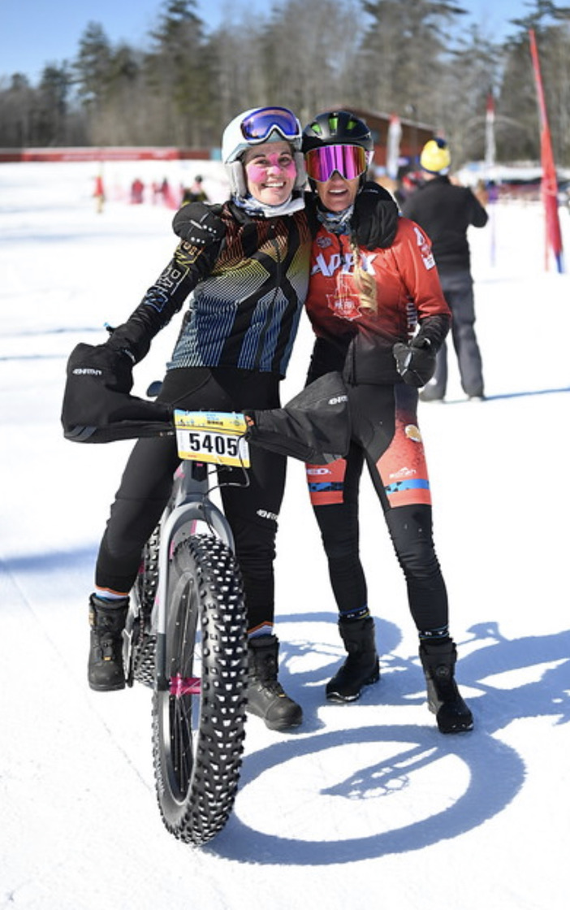

Slide 27
The most important thing for me
Is a complete change of clothes for immediately after I have finished riding

Slide 28
What do you want to share with the group?
What works for you that I didn’t mention?
What brand of gloves, heated socks/gloves, boots do you love?
Notes:
Heated things have come a long way in recent years, what products are you finding that stand up to your riding and work reliably

Slide 29
Questions?

